Slide 1
Programming with functions

Slide 2
Functions
A function has a form:
name <- function(argument_1, argument_2, …) { expression_1 expression_2 … return(output) }
argument_1, arguments_2 are the names of variables.
name is the name of function.
To call or run the function we type:
name(x1, x2, …)
the value of this expression is the value of output.

Slide 3
Functions(2)
A function may have more than one return statement, in which case it stops after executing the first one it reaches.
If there is no statement return(output) then the value returned by the function is the values of the last expression in the braces.
A function always returns a value.
For some functions the value returned is unimportant.
In such cases one usually omits the return statement, or returns NULL.
If the value returned by a function is not assigned to a variable, then it is printed.

Slide 4
Find zeros of a2*x^2+a1*x+a0=0
quad3 <- function(a0, a1, a2) {
if(a2 == 0 && a1 == 0 && a0 == 0) { roots <- NA } else if (a2 == 0 && a1 == 0 ) { roots <- NULL } else if ( a2 == 0 ) { roots <- -a0/a1 } else { discrim <- a1^2 - 4*a2*a0 if (discrim > 0) { roots <- (-a1 +c(1,-1) * sqrt(a1^2-4*a2*a0))/(2*a2) } else if (discrim == 0) { roots <- -a1/(2*a2) } else { roots <- NULL } } return(roots) }

Slide 5
Functions(3)
The most important advantage of using a function is that once it is loaded, it can be used again and again without having to reload it.
The second most important use of functions is to break down a programming task into smaller logical units.

Slide 6
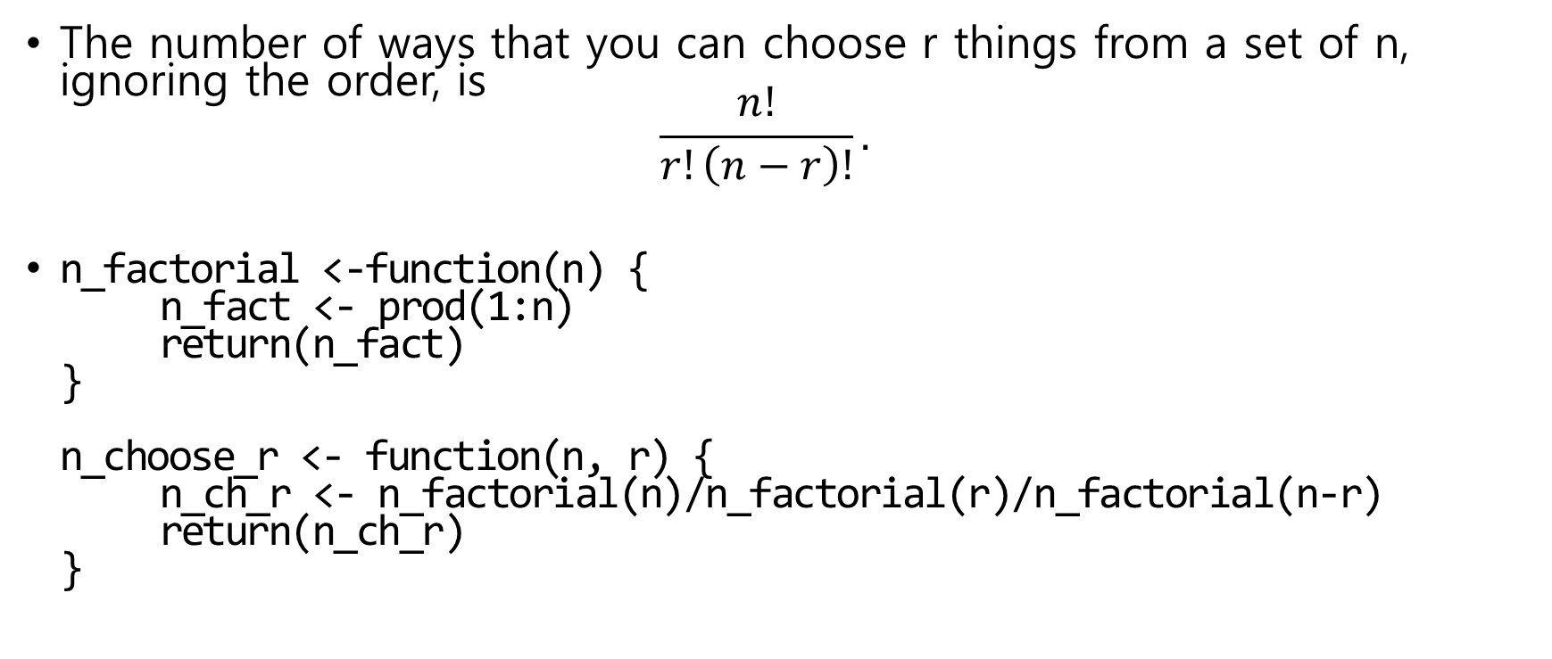
n choose r
The number of ways that you can choose r things from a set of n, ignoring the order, is $\frac{n!}{r!\left(n−r\right)!}.$
n_factorial <-function(n) { n_fact <- prod(1:n) return(n_fact) } n_choose_r <- function(n, r) { n_ch_r <- n_factorial(n)/n_factorial(r)/n_factorial(n-r) return(n_ch_r) }

Slide 7
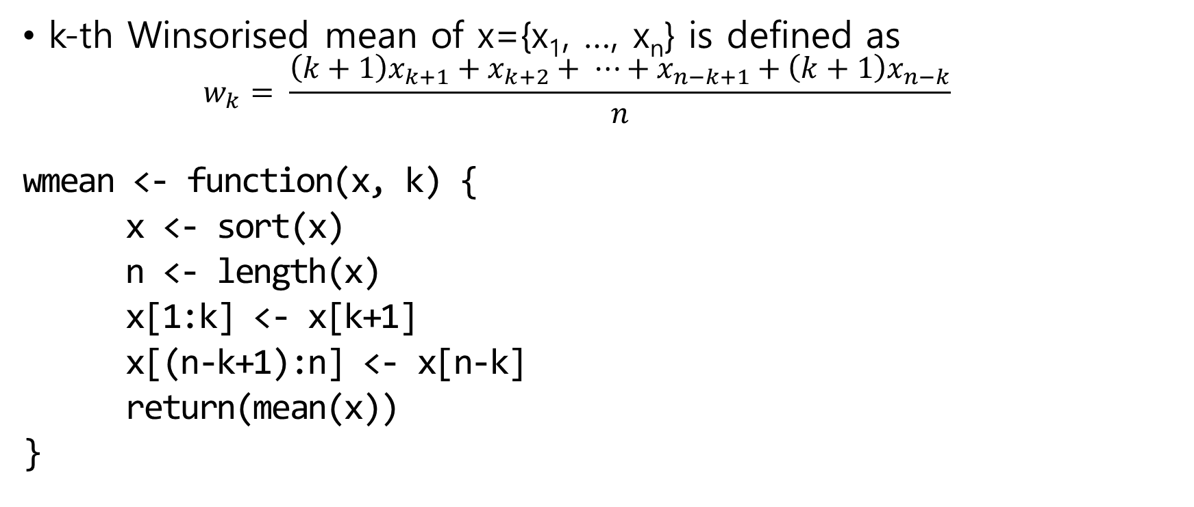
Winsorised mean
k-th Winsorised mean of x={x₁, …, x_{n}} is defined as
$$w_{k}= \frac{\left(k+1\right)x_{k+1}+x_{k+2}+ ⋯+x_{n−k+1}+\left(k+1\right)x_{n−k}}{n}$$
wmean <- function(x, k) {
x <- sort(x)
n <- length(x)
x[1:k] <- x[k+1]
x[(n-k+1):n] <- x[n-k]
return(mean(x))
}

Slide 8
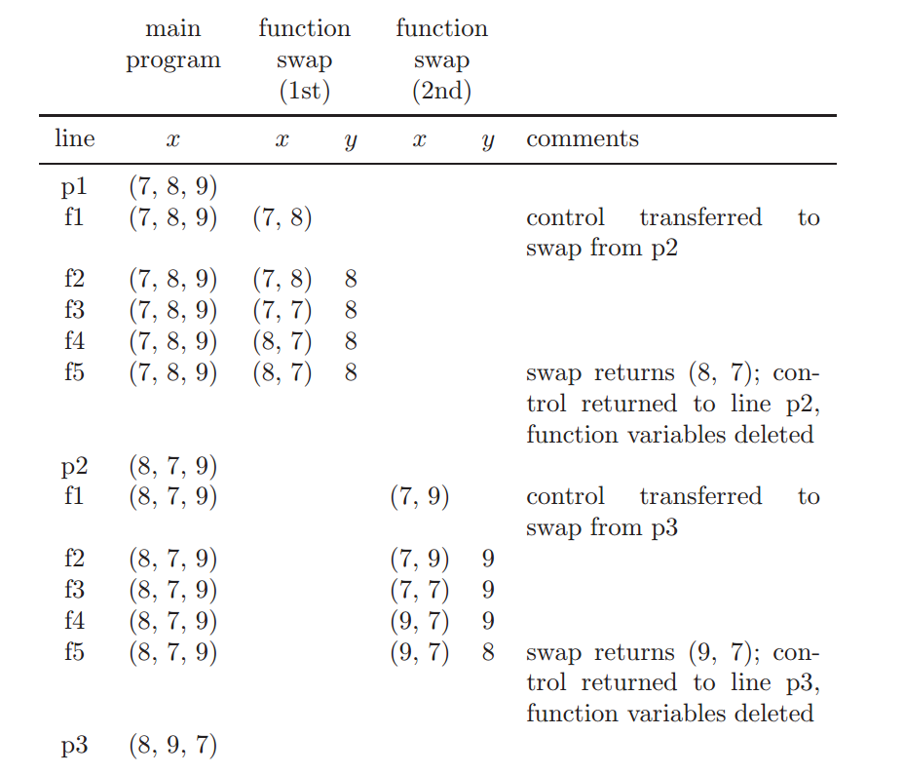
Swap
#swap values of x[1] and x[2]
f1 swap <- function(x){ f2 y <- x[2] f3 x[2] <- x[1] f4 x[1] <- y f5 return(x) f6 } p1 x <- c(7, 8, 9) p2 x[1:2] <- swap(x[1:2]) p3 x[2:3] <- swap(x[2:3])

Slide 9
Scope and its consequences
Argument and variables defined within a function exist only within that function.
If you define and use a variable x inside a function, it does not exist outside the function.
If variables with the same name exist inside and outside a function, then they are separate and do not interact at all.
The variable defined outside the function can be seen inside the function (provided there is not a variable with the same name defined inside).

Slide 10
Scope and its consequences(2)
test <- function(x) { y <- x+1 return(y) } > test(1) [1] 2 > y Error : Object "y" not found
test2 <- function(x) { y <- x + z return(y)
} > z <- 1 > test2(1) [1] 2 > z<- 2 > test2(1) [1] 3

Slide 11
Optional argument and default value
To give argument_1 the default value x1 we use argument_1 = x1 within the function definition.
If an argument has a default then it may be omitted when calling the function, in which case the default is used.
test3 <- function(x=1, y=1, z=1) { return(x*100+y*10+z) } > test3(2,2) [1] 221 > test3(y=2, z=2) [1] 122

Slide 12
Vector-based programming
Many R functions are vectorised.
To further facilitate vector-based programming, R provides functions that enable the vectorisation of user-defined functions.
apply, sapply, lapply, tapply, and mapply.
sapply(X, FUN)
apply function FUN to every element of vector X.

Slide 13
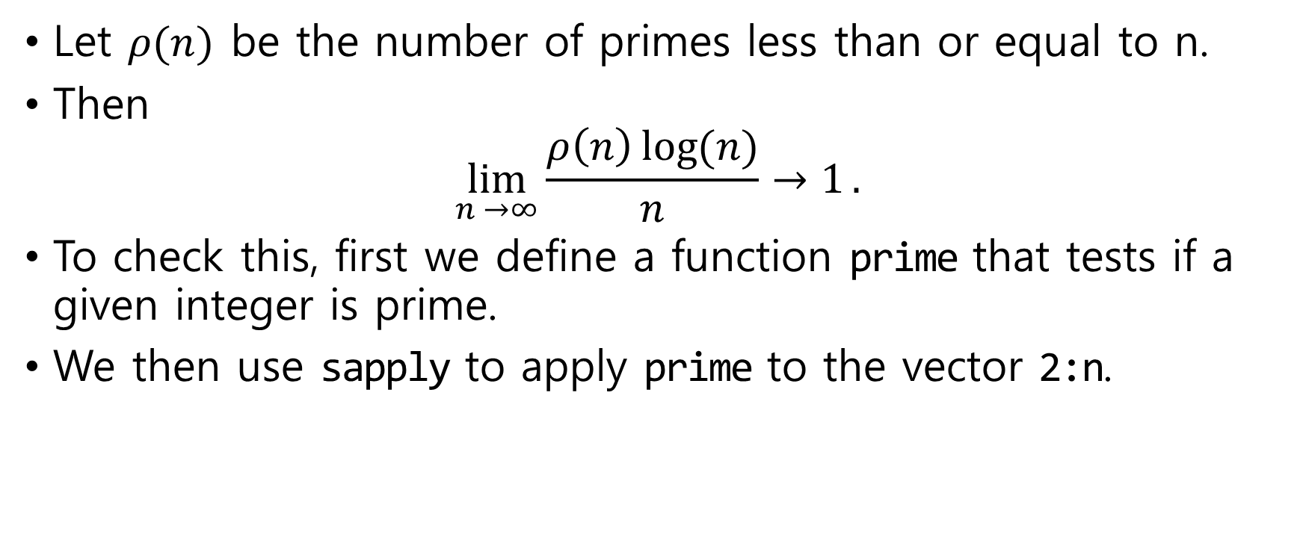
Density of primes – sapply
Let $ρ(n)$ be the number of primes less than or equal to n.
Then $\lim_{n →∞}{\frac{ρ\left(n\right)\log{(n)}}{n}→1}.$
To check this, first we define a function prime that tests if a given integer is prime.
We then use sapply to apply prime to the vector 2:n.

Slide 14
Test prime
prime <- function(n) { if ( n==1 ) { is.prime <- FALSE } else if ( n==2) { is.prime <- TRUE } else { is.prime <- TRUE for ( m in 2:(n/2) ) {
if ( n%%m == 0 ) is.prime <- FALSE } } return(is.prime) }

Slide 15
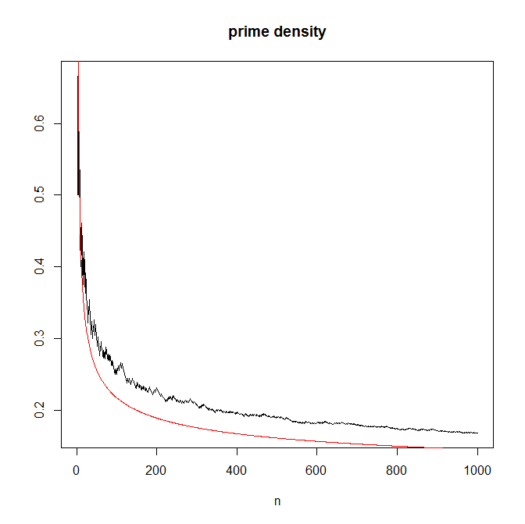
prime density
n <- 1000
m.vec <- 2:n
primes <- sapply(m.vec, prime)
num.primes <- cumsum(primes)
plot(m.vec, num.primes/m.vec, type = "l", main = "prime density", xlab = "n", ylab = "")
lines(m.vec, 1/log(m.vec), col= "red")

Slide 16
Recursive programing
A recursive program is one that calls itself.
This is useful because many algorithms are recursive in nature.

Slide 17
n factorial
nfact2 <- function(n) { if (n==1) { cat("called nfact2(1)\n") return(1) } else { cat("called nfact2(", n, ")\n", sep="") return(n*nfact2(n-1)) } }

Slide 18
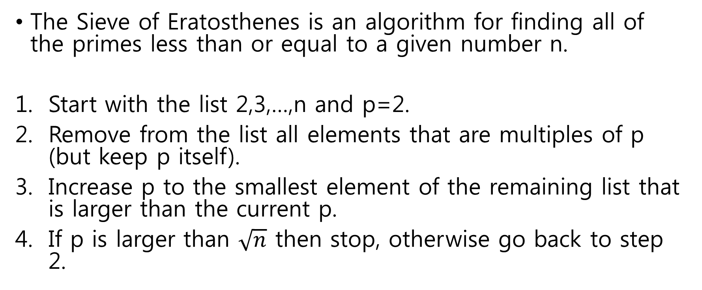
Sieve of Eratosthenes
The Sieve of Eratosthenes is an algorithm for finding all of the primes less than or equal to a given number n.
Start with the list 2,3,…,n and p=2.
Remove from the list all elements that are multiples of p (but keep p itself).
Increase p to the smallest element of the remaining list that is larger than the current p.
If p is larger than $\sqrt{n}$ then stop, otherwise go back to step 2.

Slide 19
Sieve of Eratosthenes(2)
primesieve <- function(sieved, unsieved) { p <- unsieved[1] n <- unsieved[length(unsieved)] if ( p^2 > n ) { return(c(sieved, unsieved)) } else { unsieved <- unsieved[unsieved %% p != 0] sieved <- c(sieved, p) return(primesieve(sieved, unsieved)) } }

